Slide 1

Hospital IT Department
AMAN HAMIDSHA
RIYA MARY
AAYAN EBRAHIM

Slide 2
Role of IT Department in Hospital
* Managing the hospital network.
* Tech Support.
* Communicates and coordinates with all the other departments to ensure hospital operations are running smoothly.
* Managing the HIS, and all its components.

Slide 3
Significance of IT department
* IT department is the “backbone of all modern hospital operations”.
* Helps increase customer care quality when the available technology is used effectively.
* Can properly keep track of and maintain all sorts of medical reports, prescription reports, billing information etc.
* Helps all the departments in the hospital communicate and collaborate effectively.

Slide 4
H.I.S.
HOSPITAL INFORMATION SYSTEM (SEE VIDEO)

Slide 5
How the video was prepared:
The next slide will display the unique way in which we have curated our video. It is to signify that IT is everywhere and even a project about IT is prepared using IT (presentation, video etc.)

Slide 6
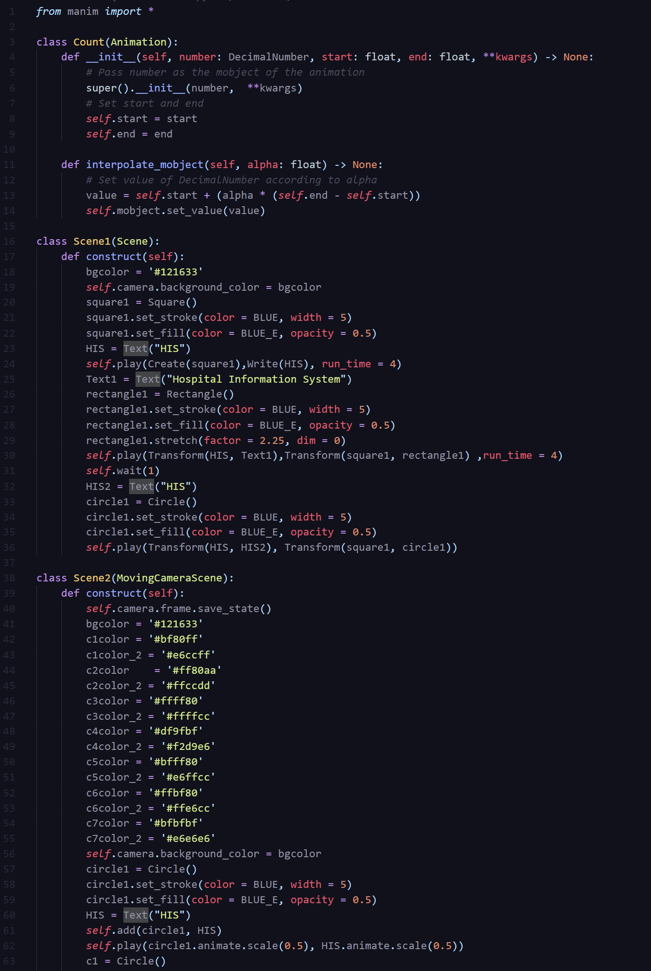
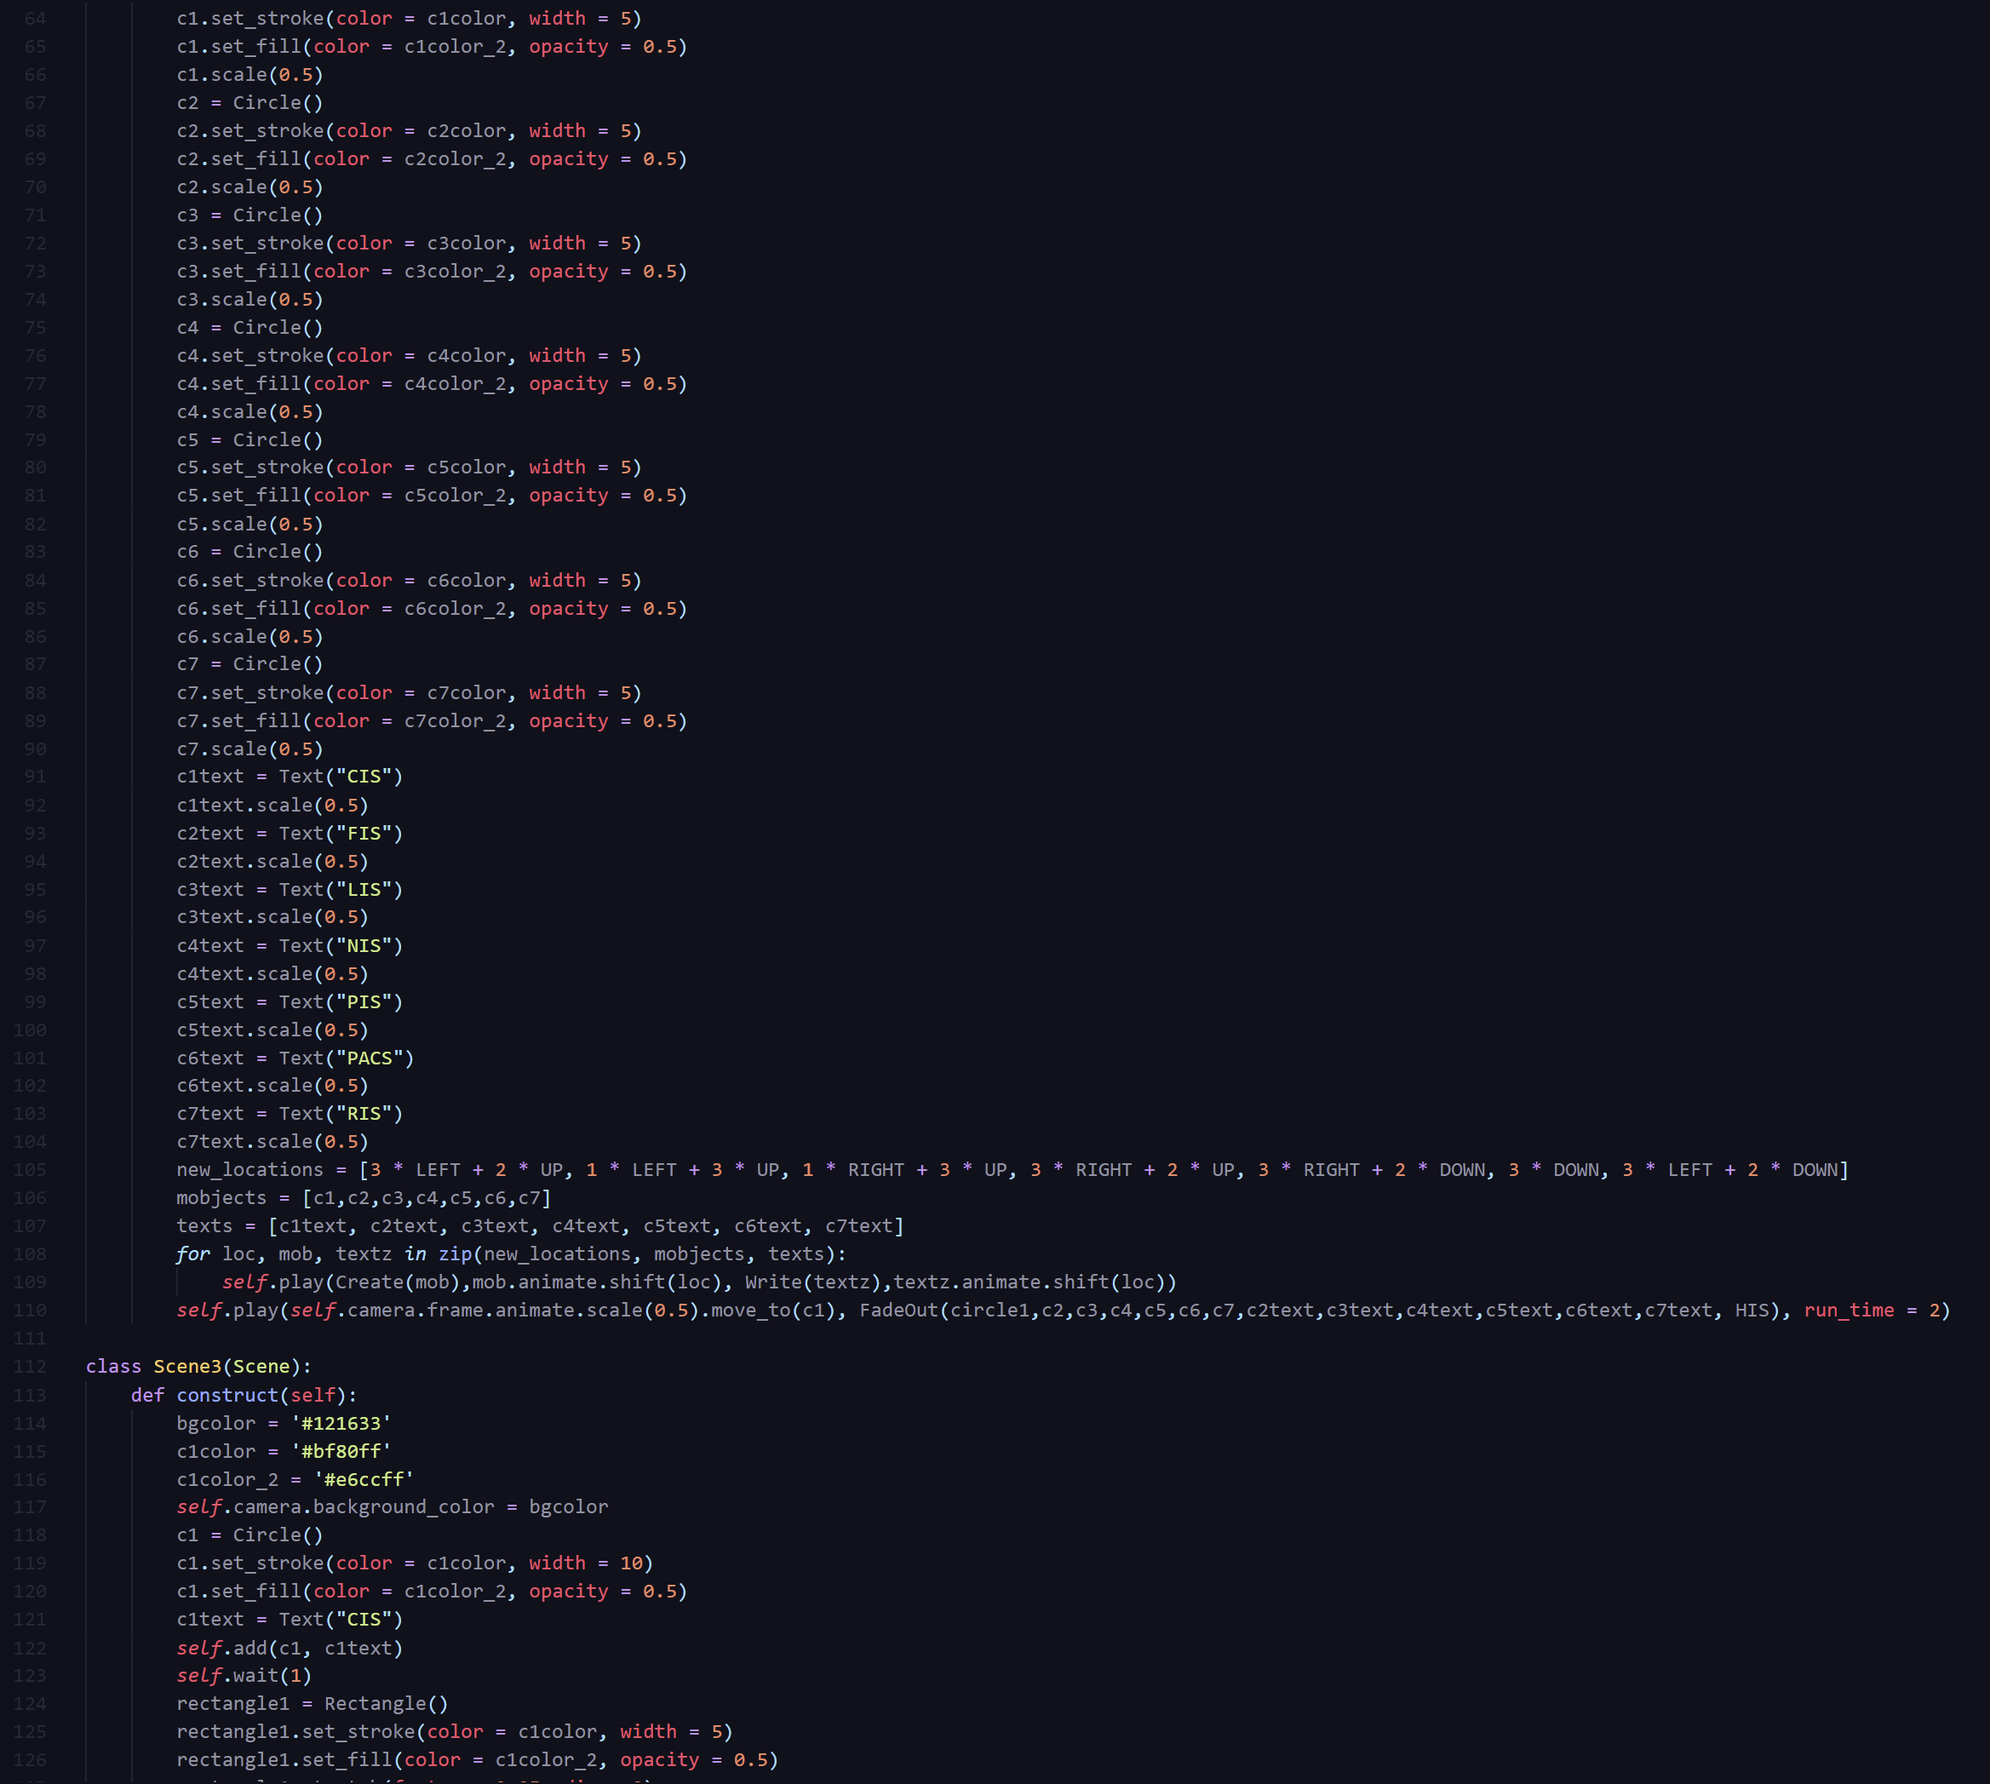
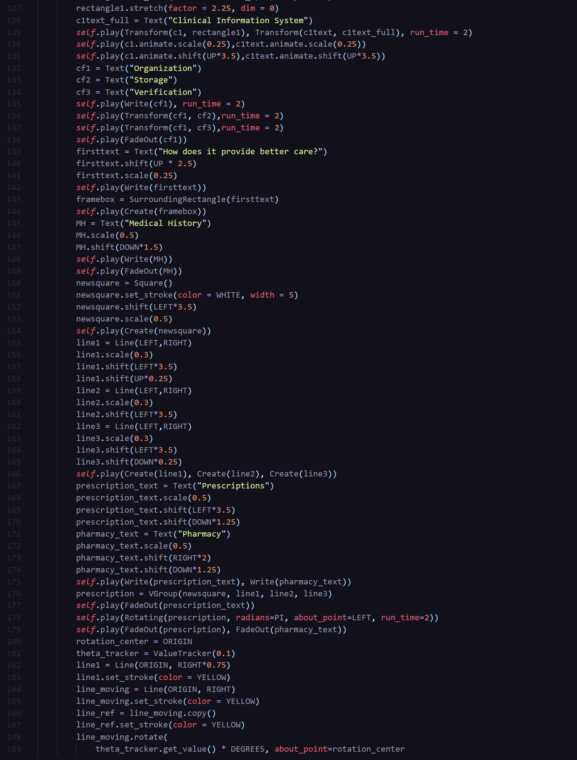
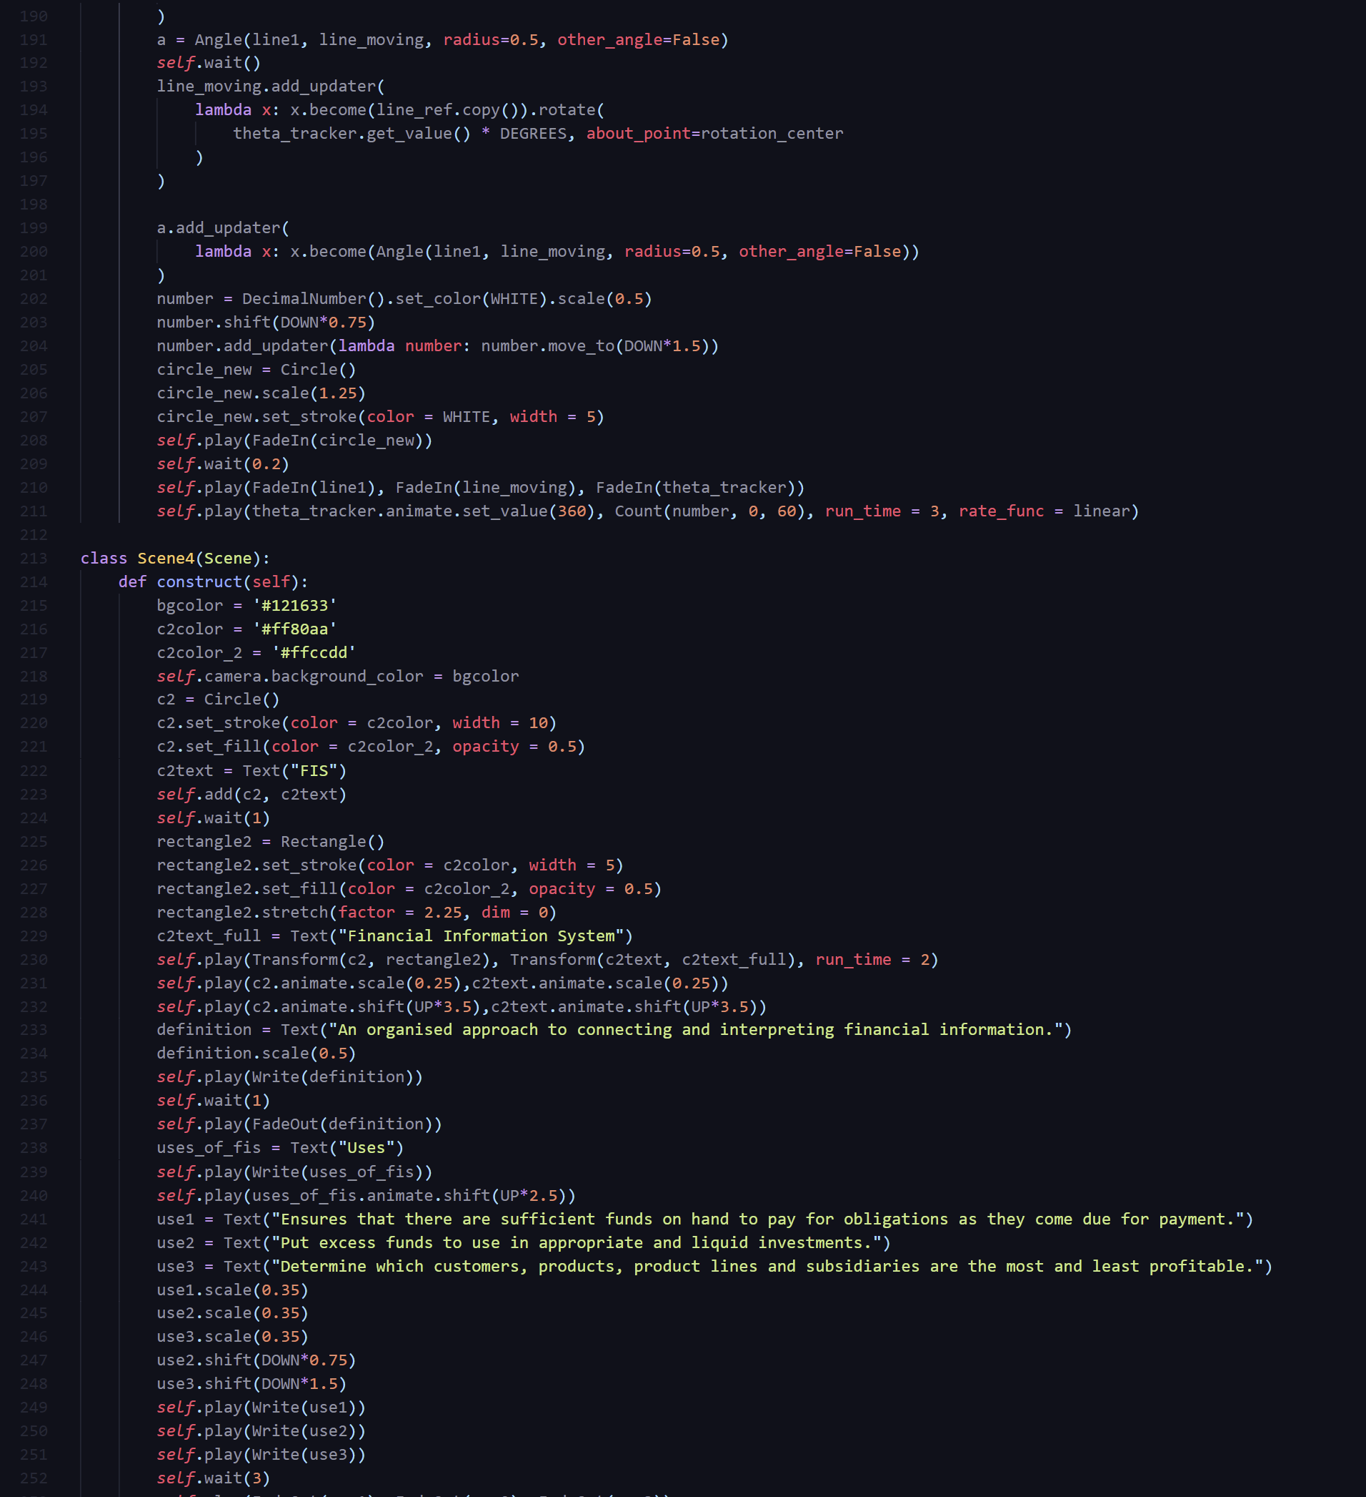
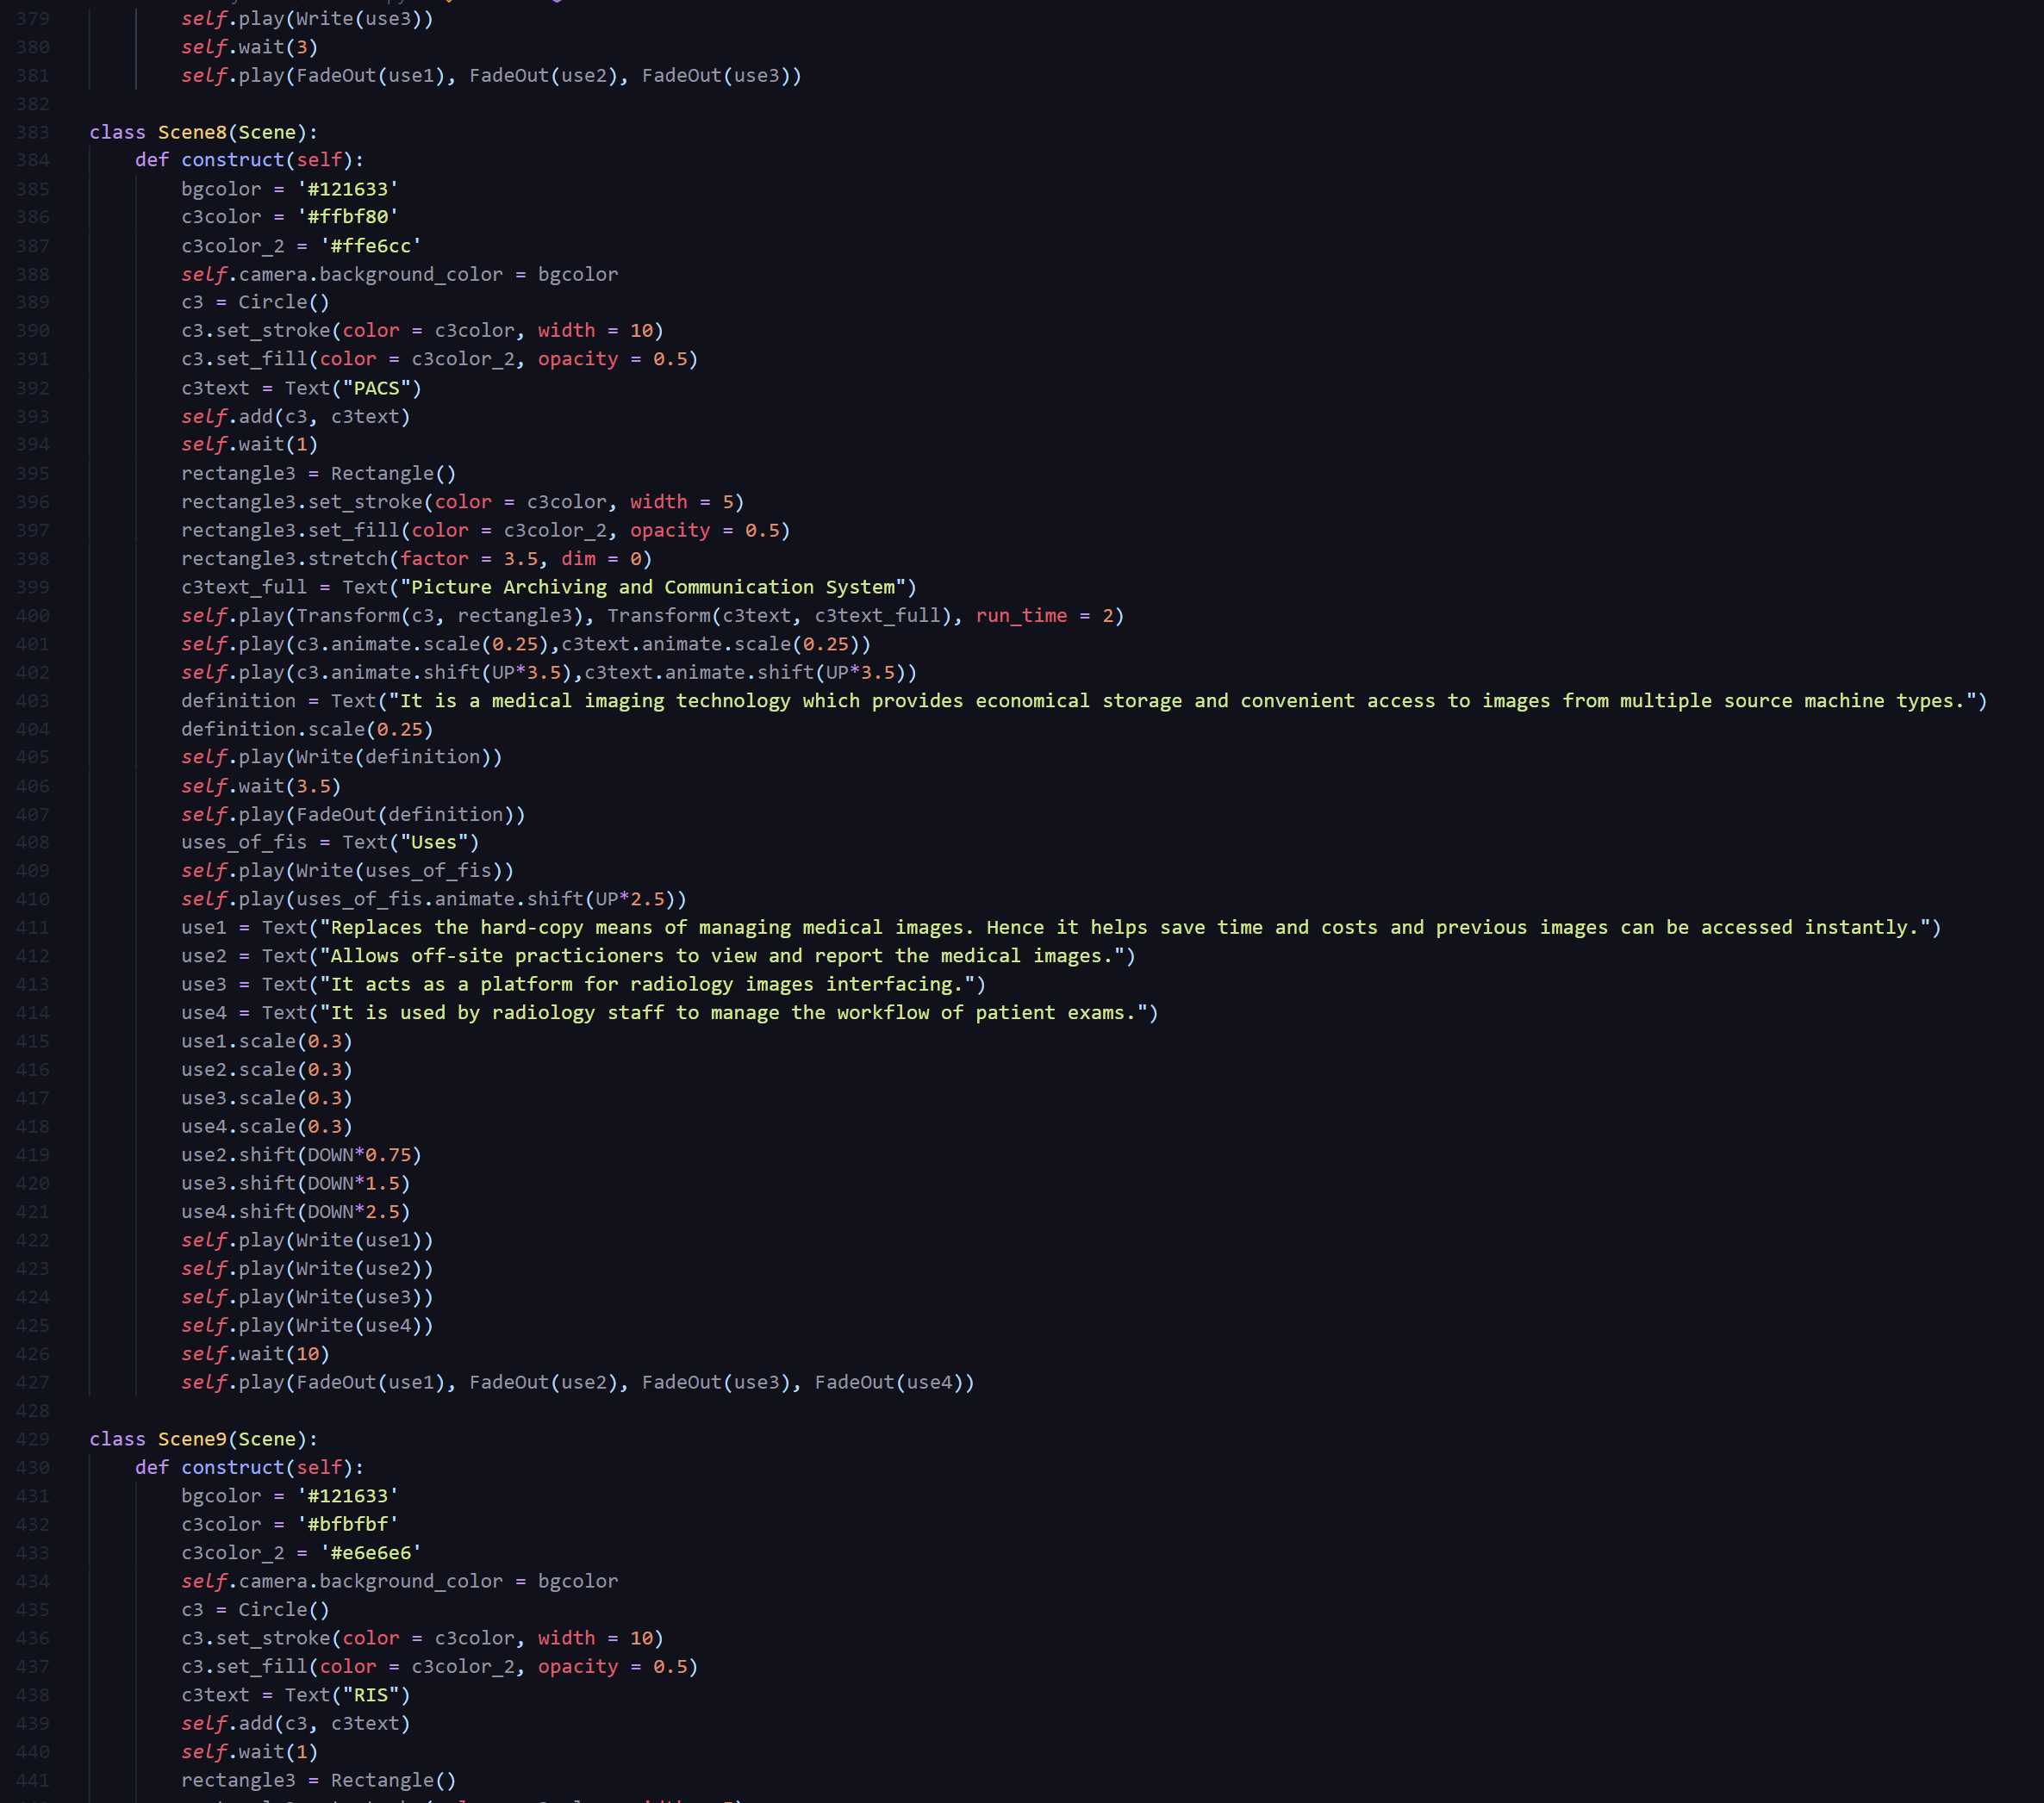
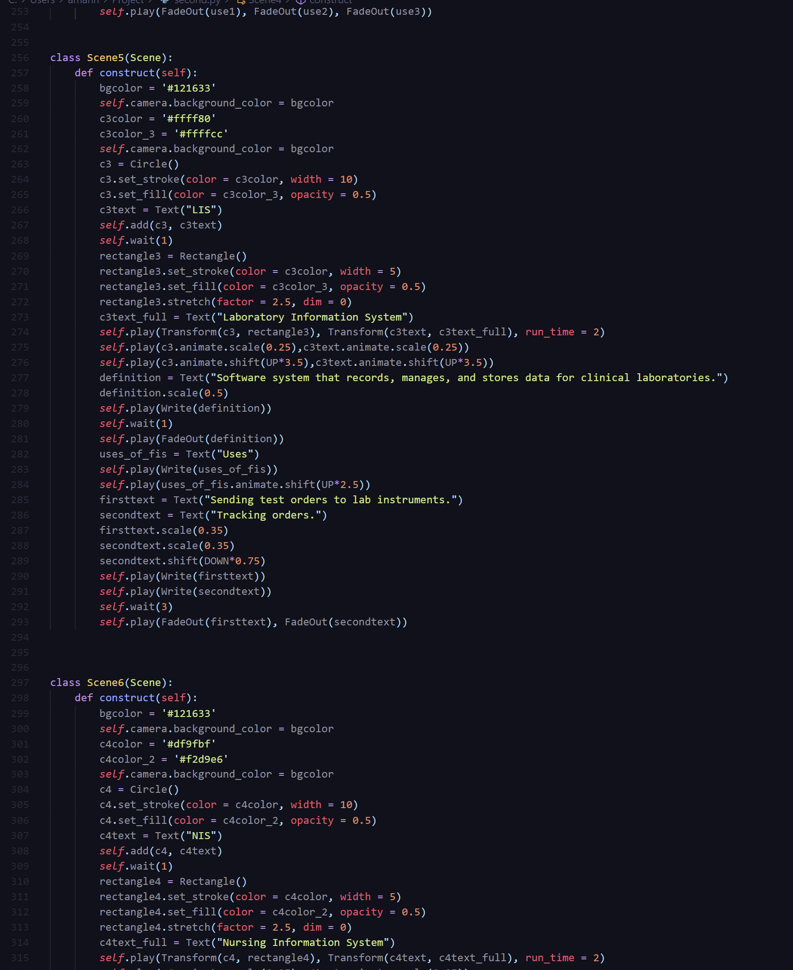
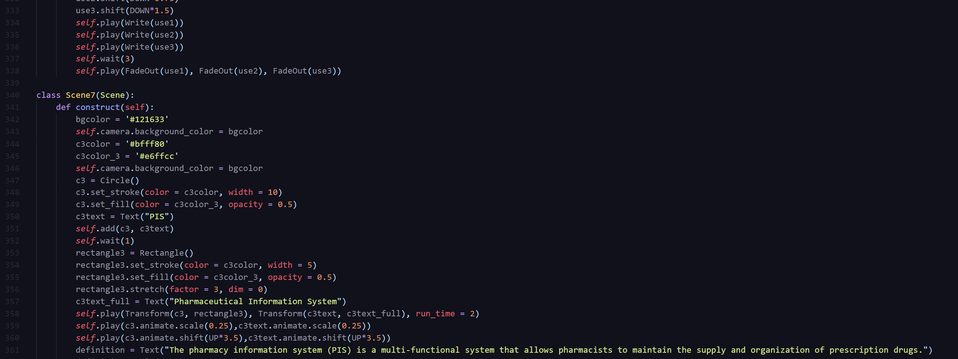
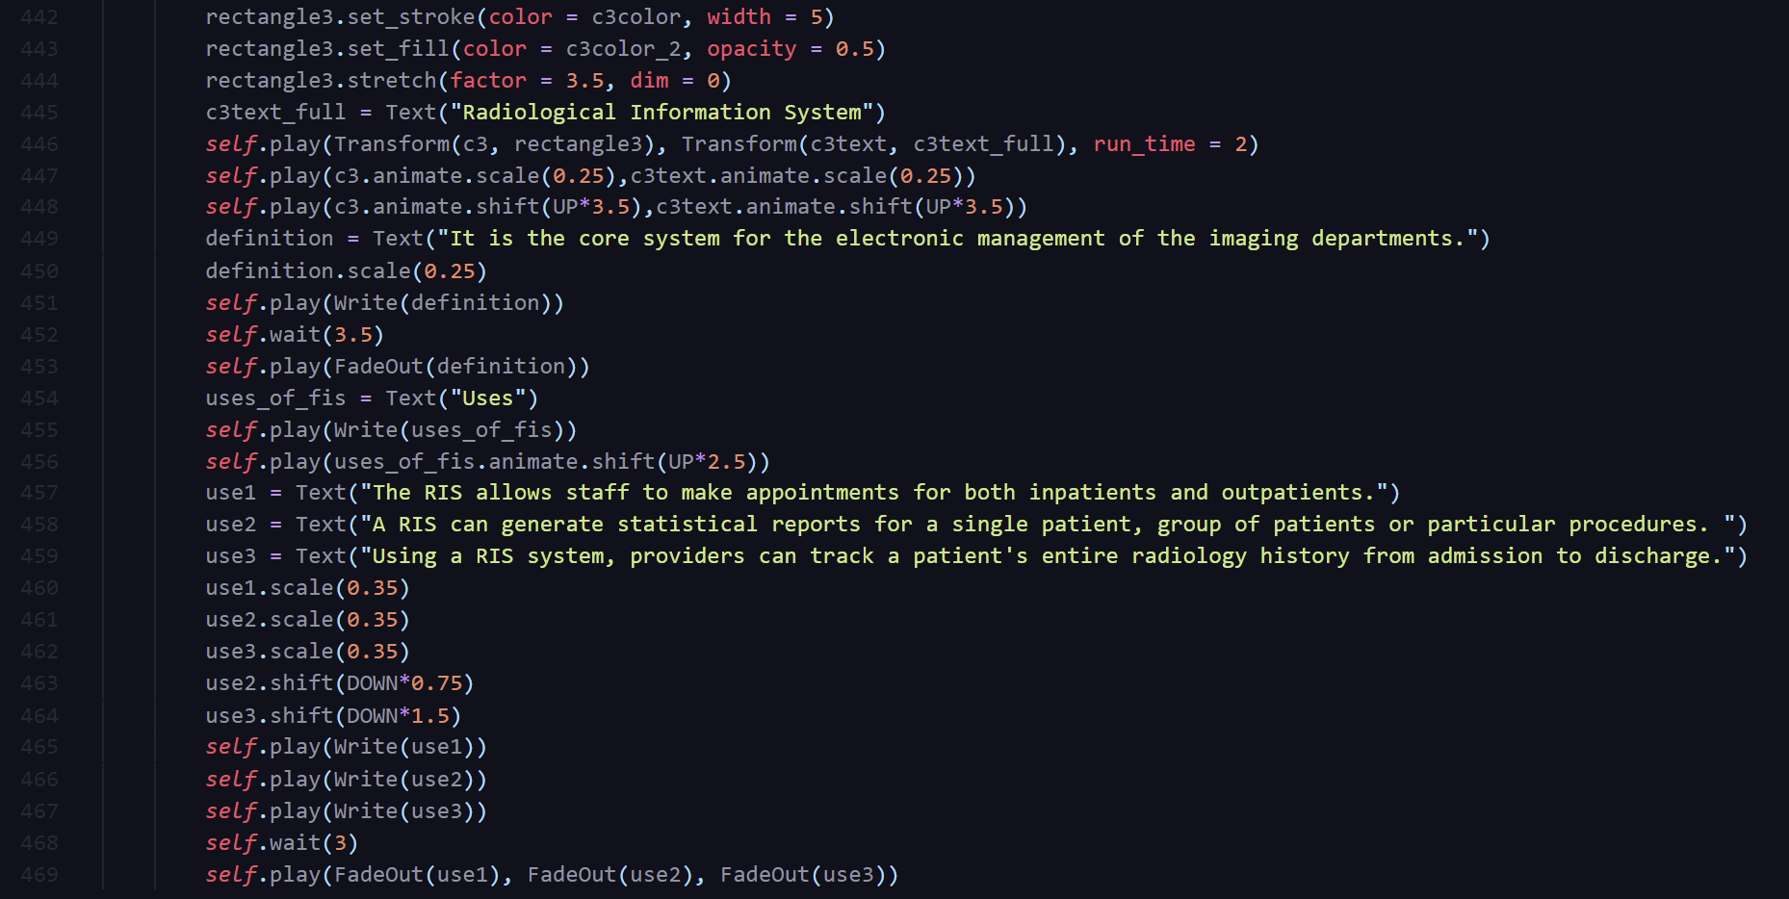
Animation Created in Python
Manim Module,
469 lines of code

Slide 7

Thank You
Video animated and edited by: Aman Hamidsha and Aayan Ebrahim
Research, Presentation, and Speech Preparation: Riya Mary Joseph

